Slide 2
Wind turbine control basics
Wind Turbine Control Online Course
Alan Wai Hou Lio
Researcher, DTU Wind Energy
wali@dtu.dk

Slide 3
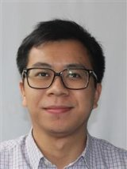
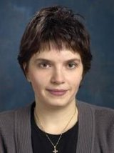
Lecturers
Alan Wai Hou Lio
Researcher, DTU Wind Energy
wali@dtu.dk
Day 1, 2 and 3
Anca Daniela Hansen
Associate Professor, DTU Wind Energy
anca@dtu.dk
Day 4

Slide 4
Nergica introduction
Background
What do you do daily in your work?
Why are you interested in this course?

Slide 5
Course structure
Old
New
Day 1
8:00-9:15 Lecture 1: Wind turbine control basics:
9:30-10:45 Lecture 2: Controller design and tuning: Region 2 (Below-rated region)
10:45-11:00 Introduction to mini-project and Matlab turbine model
Day 2
8:00-9:15 Lecture 3: Controller design and tuning: Region 2.5 and 3 (transition and above-rated region)
9:30-10:45 Q&A on mini-project
Day 3
8:00-9:15 Lecture 4: Introduction to Supervisory control, advanced control topics and DTU Wind Energy Controller
9:30-10:45 Mini-project presentations
Day 4
8:00-10:00 Lecture 5: Introduction to electrical control concepts
Day 1
8:00-9:15 Lecture 1: Wind turbine control basics:
9:30-10:45 Lecture 2: Controller design and tuning: Region 2 (Below-rated region)
10:45-11:00 Introduction to mini-project and Matlab turbine model
Day 2
8:00-9:15 Lecture 3: Controller design and tuning: Region 2.5 and 3 (transition and above-rated region)
9:30-10:45 Q&A on mini-project
Day 3
8:00-9:15 Lecture 4: Introduction to Supervisory control, advanced control topics and DTU Wind Energy Controller
9:30-10:45 Q&A on mini-project
Day 4
8:00-10:00 Lecture 5: Introduction to electrical control concepts
10:15-11:00 Mini-project presentations

Slide 6
Learning objectives
After this session you should be able to:
List and explain the controllers used in wind turbines
Explain the control objective of each control region
Understand the Proportional-Integral (PI) controller

Slide 7


Basic control concepts
What is control? What does it mean to control a system?
Disturbance
The actions that could
influence the output
System
The expected behaviour
of the system
Inputs
Outputs
Think
Speed
(output)
Wind/other cars
(disturbance)
Sun
(disturbance)
Wind turbine
Temperature
(output)
Inputs
??
Outputs
??
Accelerator
(input)
Valve
(Input)
Disturbance ??

Slide 8
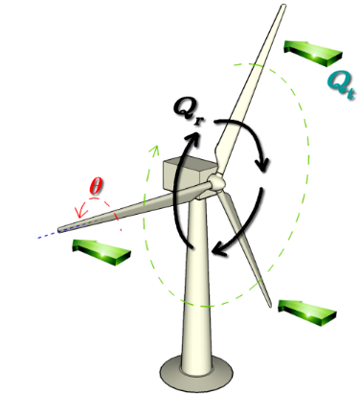
Let’s control a wind turbine
Wind
Three required controllers:
Blade pitch controller
Generator torque controller
Yaw controller
Pitch angle
Generator torque
Rotor speed
Yaw angle
Power
wind
pitch, Gen. torque,
Yaw angle
Disturbance
power, rotor speed
System
Inputs
Outputs
?

Slide 9
Wind turbine control objectives
Objectives: (1) Optimize power production at below rated wind speeds
(2) Limit power and loads at above rated wind speeds
Regions:
Variable speed, optimal power tracking
Rotor speed regulation
Power and speed regulation
Region 2.5
Region 3
Region 2
Above rated
Below rated
Pitch control
Torque control
Rated wsp

Slide 10
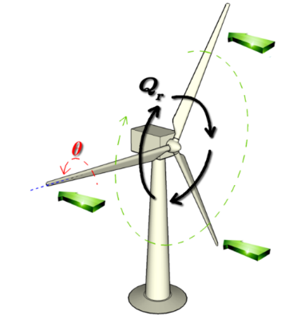
Open-loop control
In short…the output has no effect on the input
What is it?
Sun
(disturbance)
Wind
Temperature
Control Inputs
Outputs
Valve
(without thermostat)

Slide 11

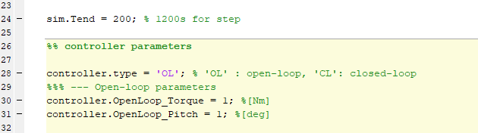
Open-loop Example: Part_1.m
DTU 10 MW
Rated power = 10MW
Rated Rotor Speed = 1.005 rad/s
Wind Speed: Steady 13 m/s, above-rated
Desired Outputs
Exercise: Open-loop controller
Open part_1.m
Change the value for OpenLoop_Torque and OpenLoop_Pitch so that the rotor speed and generated power are regulated to the desired outputs.
Tip:
Power = Rotor Speed * Torque

Slide 12
Open-loop Example: Part_1.m
Desired Outputs
inputs:
Pitch angle: 6.78 deg
Generator torque: 10e6/1.005 Nm

Slide 13
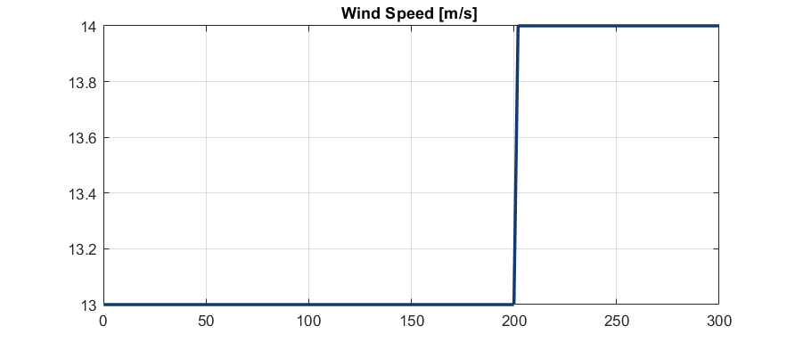
Open-loop Example: Part_1.m
Now, the wind speed (disturbance) increases from 13 m/s to 14 m/s
What will happen to the rotor speed and power?
Exercise: Open-loop controller 2
Change simulation time to 300 and see what happens
Change the simulation time to 300 s

Slide 14
Open-loop Example: Part_1.m
inputs:
Pitch angle: 6.78 deg
Generator torque: 10e6/1.005 Nm
Desired Outputs
When the simulation length is increased to 300s
Wind speed changed
Control inputs need to be changed in real-time

Slide 15

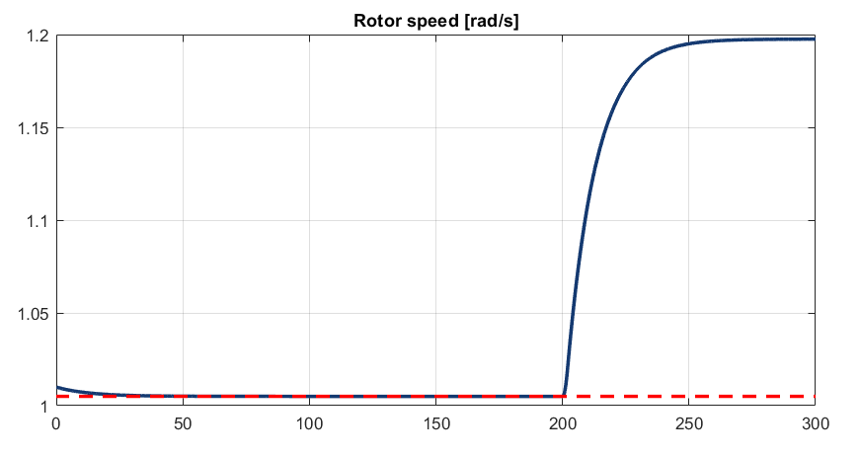

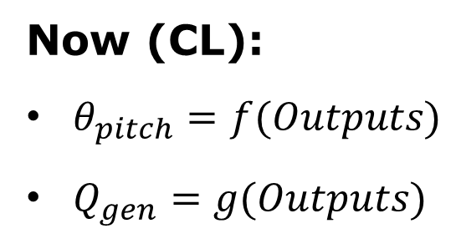
Closed-loop control
Wind
Inputs
Outputs
error
C
Before (OL):
$θ_{pitch}=θ^{∗}$
$Q_{gen}=Q^{∗}$
Set Point
Now (CL):
$θ_{pitch}=f(Outputs)$
$Q_{gen}=g(Outputs)$

Slide 16
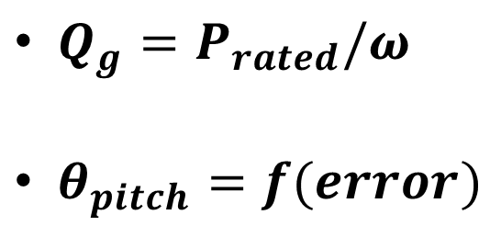
Let’s consider Region 3 control for now
Region 3
Ensures correct power
$Q_{g}=P_{rated}/ω$
$θ_{pitch}=f(error)$
Above rated
Controller! (Need to define)

Slide 17
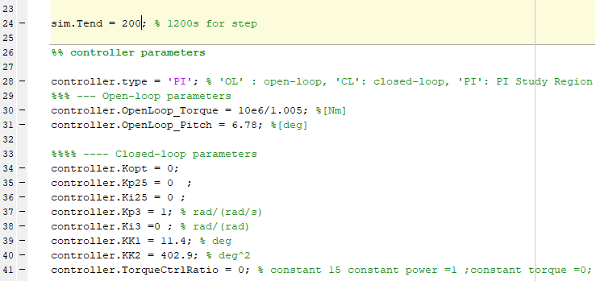

Proportional (P) controller: Part_2.m
$$θ_{p}=θ_{p}^{∗}+Kp∗error$$
Desired Outputs
Exercise: Proportional controller
Open part_2.m
Change the value for Kp3 so that the rotor speed and generated power converge to the desired outputs.
Change the simulation to 400 seconds.

Slide 18
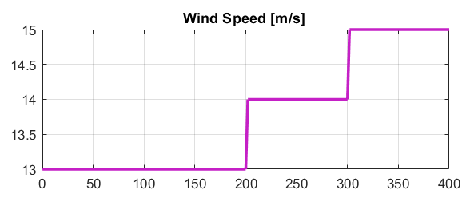
Proportional (P) controller
Kp alone cannot make the rotor speed to converge
Change in disturbance
“Offset error” → P-controller inadequate

Slide 19
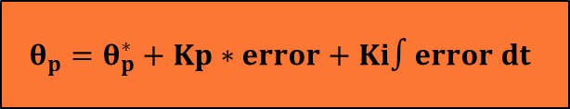
Proportional-Integral (PI) pitch controller: part_2.m
Desired Outputs
$$θ_{p}=θ_{p}^{∗}+Kp∗error+Ki∫error dt$$
Exercise: PI controller
Open part_2.m
Change the values for Kp3 and Ki3 so that the rotor speed and generated power converge to the desired outputs
Change the simulation to 400 seconds. What do you see?
19

Slide 20

Proportional-Integral (PI) pitch controller
Controller (Need to designed)
$$θ_{p}=θ_{p}^{∗}+Kp∗error+Ki∫error dt$$
Results: Kp = 10.8, Ki = 2.2
Rotor speed is regulated!
Power is regulated!

Slide 21
How about the derivative (D) term?
$$θ_{p}=θ_{p}^{∗}+Kp∗error+Ki∫error dt+Kd ∗\frac{d error}{dt}$$
Not commonly used in wind turbine control
Derivative of the measurement typically contains noises
Filtered rotor speed measurement from V52 and its derivative

Slide 22
Summary
In an open-loop system, the controller does not use the knowledge of the system measurement
Closed-loop controller regulates the system (wind turbine) based on the feedback mechanism.
The system input is in response to the system measurement
Proportional controller alone cannot regulate the system to the desired output without an offset
Proportional-Integral (PI) controller can successfully regulate the system and minimise any offset between the desired output and system measurement.

